Slide 1
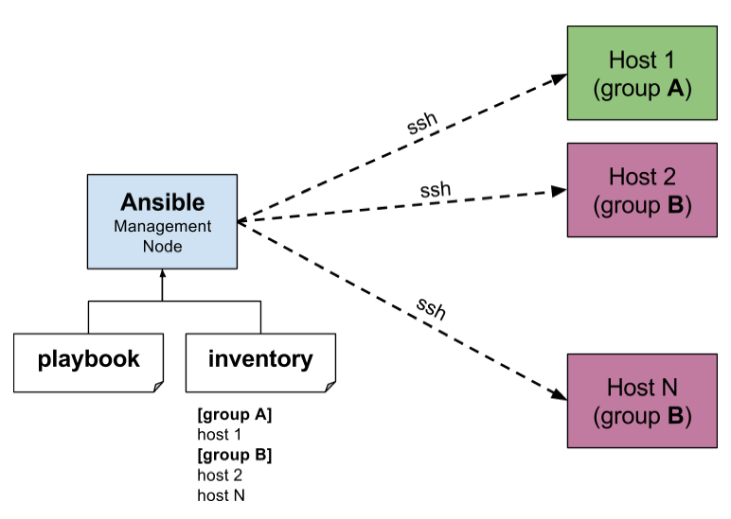
Setting Up Ansible Friendly Env

Slide 2
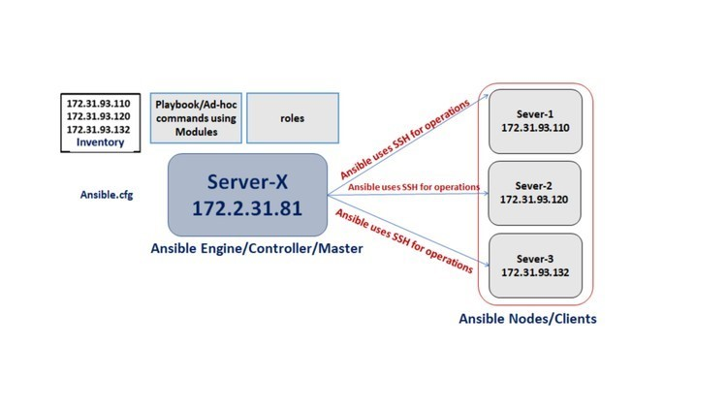

Slide 3
Spin up 3 servers with centos 7 Image, name them as follows
ansible-master, ansible-node1, ansible-node2
Create User ansible in all 3 servers
#sudo useradd ansible
#sudo passwd ansible
edit the sshd_config file of all your 3 servers to allow the password based login on the
sudo sed -i 's/.*PasswordAuthentication no/Passwordauthentication yes/g' /etc/ssh/sshd_config
sudo sed -i 's/.*#PermitRootLogin yes/PermitRootLogin yes/g' /etc/ssh/sshd_config
sudo echo "ansible ALL=(ALL) NOPASSWD: ALL" >> /etc/sudoers
—------------------------------------------------ Not required as the above commands are the short cuts
#sudo vi /etc/ssh/sshd_config
:/PasswordAuthentication :
:/PermitRootLogin
PermitRootLogin no to PermitRootLogin yes
PasswordAuthentication no to PasswordAuthentication yes
—------------------------------------------------ Not required as the above commands are the short cuts
#sudo service sshd restart

Slide 4
To begin exploring Ansible as a means of managing our various servers, we need to install the Ansible software on ansible master. What ever we are doing below is only in the ansible-master
To get Ansible for CentOS 7, first ensure that the CentOS 7 EPEL repository is installed:
#sudo yum install epel-release -y
Once the repository is installed, install Ansible with yum:
#sudo yum install ansible -y

Slide 5
Ansible keeps track of all of the servers that it knows about through a "hosts" file. We need to set up this file first before we can begin to communicate with our other computers.
Open the file with root privileges like this:
#sudo vi /etc/ansible/hosts
[webserver]
Ip address of ansible-node1
Ip address of ansible-node2
In your ansible-master, login as user ansible and generate ssh key on ansible control server
#ssh ansible@ip address of the master server

Slide 6
Create an ssh key in master server and copy it to node servers This will create .ssh folder (/home/ansadm/.ssh). Hit enter all the way through
#ssh-keygen -t rsa
This will create .ssh folder (/home/ansible/.ssh). Hit enter all the way through
#chmod 700 /home/ansible/.ssh
#ssh-copy-id ansible@ip address of you ansible-node1
#ssh-copy-id ansible@ip address of you ansible-node2
#ssh ansible@ip address of you ansible-node1
#ssh ansible@ip address of you ansible-node2

Slide 7
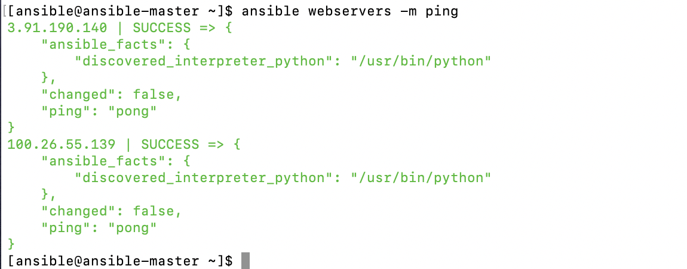
Now all three servers are configured, ansible control server can do ssh on both the servers
check connectivity of hosts is
#ansible <group> -m ping

Slide 8
Check if package is installed & update it
$ ansible <group> -m yum -a “name=ntp state=latest”
Check if package is installed & don’t update it
$ ansible <group> -m yum -a “name=ntp state=present”
Check if package is at a specific version
$ ansible -i <group> -b -m yum -a “name= ntp-1.8 state=present”
$ ansible -i <group> -b -m yum -a “name= ntp-1.8 state=latest”
Now check the RAM Memory usage on all servers using the 'free -m' command.
ansible hakase-testing -m shell -a 'free -m' --become
Check the disk available on the root partition using the fdisk command.
ansible hakase-testing -m shell -a 'df -h /dev/sda2' --become
Install a single package using the ad-hoc command with the apt module as below.
ansible hakase-testing -m yum -a 'name=nginx state=latest' --become
Now check the uptime of each server.
ansible hakase-testing -m shell -a 'uptime' --become
Check if package is not installed
$ ansible <group> -b -m yum -a “name=ntp state=absent”
Starting a service
$ ansible <group> -b -m service -a “name=httpd state=started”
Stopping a service
$ ansible <group> -b -m service -a “name=httpd state=stopped”
Restarting a service
$ ansible <group> -b -m service -a “name=httpd state=restarted”

Slide 9
Working with file module
$ ansible -i <group> -b -m file -a “name=/root/test state=touch”
$ ansible -i <group> -b -m file -a “name=/root/test state=absent”
Creating system user with user and modules
$ ansible -i <group> -b -m user-a “name=user1 state=present”
$ ansible -i <group> -b -m user-a “name=jjtech state=absent”
$ ansible -i <group> -b -m group -a “name=group1”
$ ansible -i <group> -b -m user -a “name=user1 group=group1”
Ansible Glossary
The following Ansible-specific terms are largely used throughout this guide:
Control Machine / Node: a system where Ansible is installed and configured to connect and execute commands on nodes.
Node: a server controlled by Ansible.
Inventory File: a file that contains information about the servers Ansible controls, typically located at /etc/ansible/hosts.
Playbook: a file containing a series of tasks to be executed on a remote server.
Role: a collection of playbooks and other files that are relevant to a goal such as installing a web server.
Play: a full Ansible run. A play can have several playbooks and roles, included from a single playbook that acts as entry point.

Slide 10
Running Playbooks
To run a playbook and execute all the tasks defined within isshschat, use the ansible-playbookcommand:
#ansible-playbook myplaybook.yml
To overwrite the default hosts option in the playbook and limit execution to a certain group or host, include the option -l in your command:
#ansible-playbook -l server1 myplaybook.yml
Getting Information about a Play
The option --list-tasks is used to list all tasks that would be executed by a play without making any changes to the remote servers:
#ansible-playbook myplaybook.yml --list-tasks
Similarly, it is possible to list all hosts that would be affected by a play, without running any tasks on the remote servers:
#ansible-playbook myplaybook.yml --list-hosts
You can use tags to limit the execution of a play. To list all tags available in a play, use the option --list-tags:
#ansible-playbook myplaybook.yml --list-tags
#ansible-playbook packages.yml
#ansible --list-hosts all

